Slide 1

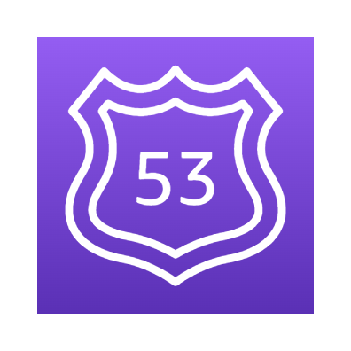




AWS Cloud
Amazon Route53
eks-blueprint VPC
Add-Ons repository
https://github.com/aws-samples/eks-blueprints-add-ons
eks-blue
Workloads repository
https://github.com/seb-demo/eks-blueprints-workloads
EKS Add-Ons
Namespace: argocd
EKS Workloads

Slide 2

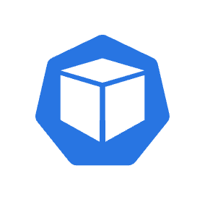

Route 53 Weighed record points to Blue
AWS Cloud
Amazon Route53
eks-blueprint VPC
Eks-blue weighted route
Eks-green weighted route
100
0
eks-blue
eks-green
Namespace: external-dns
Namespace: kube-system
Namespace: kube-system
Namespace: external-dns
External-dns
Aws-load-balancer-controller
Aws-load-balancer-controller
External-dns
Burnham-ingress
Burnham-ingress
Namespace: team-burnham
Namespace: team-burnham
Burnham-pod
Burnham-pod
Burnham-pod
Burnham-pod
Burnham-pod
Burnham-pod

Slide 3
Route 53 Weighed record points to Blue and Green
AWS Cloud
Amazon Route53
eks-blueprint VPC
Eks-blue weighted route
Eks-green weighted route
100
50
eks-blue
eks-green
Namespace: external-dns
Namespace: kube-system
Namespace: kube-system
Namespace: external-dns
External-dns
Aws-load-balancer-controller
Aws-load-balancer-controller
External-dns
Burnham-ingress
Burnham-ingress
Namespace: team-burnham
Namespace: team-burnham
Burnham-pod
Burnham-pod
Burnham-pod
Burnham-pod
Burnham-pod
Burnham-pod

Slide 4
Route 53 Weighed record points to Green
AWS Cloud
Amazon Route53
eks-blueprint VPC
Eks-blue weighted route
Eks-green weighted route
0
100
eks-blue
eks-green
Namespace: external-dns
Namespace: kube-system
Namespace: kube-system
Namespace: external-dns
External-dns
Aws-load-balancer-controller
Aws-load-balancer-controller
External-dns
Burnham-ingress
Burnham-ingress
Namespace: team-burnham
Namespace: team-burnham
Burnham-pod
Burnham-pod
Burnham-pod
Burnham-pod
Burnham-pod
Burnham-pod

Slide 5




AWS Cloud
Availability Zone A
Availability Zone B
Availability Zone C
Argocd secrets
eks-blueprint VPC
Internet gateway
Public subnet a
Public subnet b
Public subnet c
NAT gateway
Private subnet a
Private subnet b
Private subnet c

Slide 6



AWS Cloud
Availability Zone A
Availability Zone B
Availability Zone C
Argocd secrets
eks-blueprint VPC
Internet gateway
Public subnet a
Public subnet b
Public subnet c
NAT gateway
eks-blue
Private subnet a
Private subnet b
Private subnet c
Managed Node Group
Instance
Instance
Instance

Slide 7
AWS Cloud
Argocd secrets
eks-blueprint VPC
Internet gateway
eks-blueprint-blue EKS
Add-Ons repository
https://github.com/aws-samples/eks-blueprints-add-ons
EKS Add-Ons
Namespace: argocd
Workloads repository
https://github.com/aws-samples/eks-blueprints-workloads
EKS Workloads

Slide 8
AWS Cloud
eks-blueprint VPC
eks-blue
Namespace: external-dns
Namespace: kube-system
External-dns
Aws-load-balancer-controller
Namespace: team-burnham
Burnham-pod
Burnham-pod
Burnham-pod

Slide 9
Thank you!
GM, Container Services
Bob Wise

